Slide 1
Retractions in Research
Larissa Pack

Slide 2




Academic Research
Cutting-edge science, breakthrough technology, exploring medicine, discovering how people work
Takes place in universities, hospitals, and commercially
Over 250 top-tier research universities in the U.S.
For research to be utilized to its fullest extent, must publish results
Results are discussed in a manuscript and published in a journal
Some journals usually focus on specific topics; some have a wide variety of topics
Notes:
https://en.wikipedia.org/wiki/List_of_research_universities_in_the_United_States
https://library.comsats.edu.pk/Files/Impact_Fator-wise_Top100Sciene_Journals.pdf
Images:
https://logotyp.us/logo/new-england-journal-of-medicine/
https://twitter.com/nature/status/1111235243267239936
https://www.sciencemag.org/
https://pubs.acs.org/journal/chreay

Slide 3
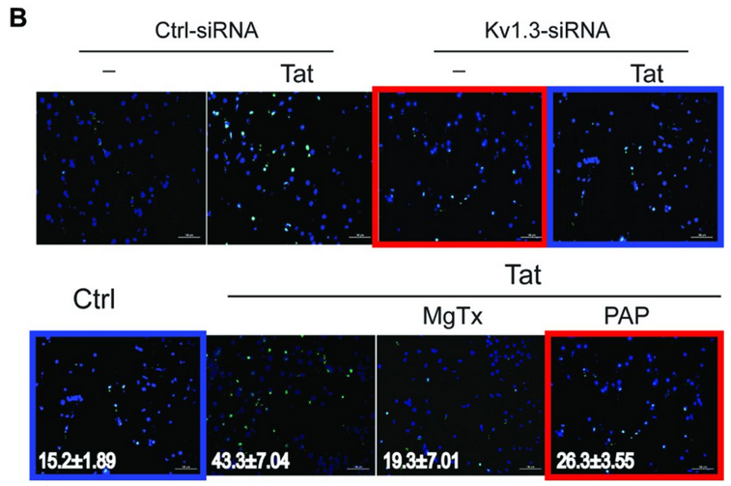
Retraction of Academic Research
1-2.5 : 10,000 published articles later retracted
Common reasons: unethical research, plagiarism
Consequences
Loss in credibility for the journal and the authors
Spread of misinformation
Increasing distrust of the scientific community both outside and in
Image Source
Notes:
https://www.elsevier.com/connect/7-steps-to-publishing-in-a-scientific-journal
https://www.ncbi.nlm.nih.gov/pmc/articles/PMC3474310/
https://journals.plos.org/plosone/s/editorial-and-peer-review-process#:~:text=PLOS%20ONE%20is%20a%20peer,related%20social%20sciences%20and%20humanities.​

Slide 4
Questions to Answer
Are there trends in research articles that reflect if the article will be retracted?
Can a natural language processing model be used to determine if a research article will be retracted?
How do we further cultivate trust with the scientific community?

Slide 5
Data Collection and Cleaning
Data Collection
Over 10,000 articles were accessed from the PubMed and PMC database
17% retracted articles
83% non-retracted articles
Retracted articles across several different journals
Non-retracted articles taken from PLOS ONE journal
Data Cleaning
Removal
Duplicate articles
Null values for article full-text
Manipulations
Retraction binary column
Removed symbols, numbers, and any string longer than 45 characters from article full-text

Slide 6
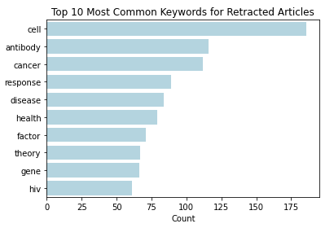
Are there trends in retracted articles?
Keywords
Used in articles to help other researchers find the project when searching databases
78% of retracted articles from the journal PLOS ONE utilized keywords
0.01% non-retracted articles utilized keywords

Slide 7
Are there trends in retracted articles?
Most common bigrams found in retracted or non-retracted articles
Retraction article bigrams:
Biological work
Human based work
Non-retraction article bigrams:
Methodology of the project
Complementary research
Retraction Only | No Retraction Only
cancer cell | time point
breast cancer | confidence interval
western blot | analysis performed
long term | sample size
cell cycle | logistic regression
blood pressure | male female
compared control | s1 file
room temperature | previously described
cell proliferation | ---

Slide 8
Are there trends in retracted articles?
Most common bigrams found in retracted or non-retracted articles
Retraction article bigrams:
Biological work
Human based work
Non-retraction article bigrams:
Methodology of the project
Complementary research
Retraction Only | No Retraction Only
cancer cell | time point
breast cancer | confidence interval
western blot | analysis performed
long term | sample size
cell cycle | logistic regression
blood pressure | male female
compared control | s1 file
room temperature | previously described
cell proliferation | ---

Slide 9
Are there trends in retracted articles?
Most common bigrams found in retracted or non-retracted articles
Retraction article bigrams:
Biological work
Human based work
Non-retraction article bigrams:
Methodology of the project
Complementary research
Retraction Only | No Retraction Only
cancer cell | time point
breast cancer | confidence interval
western blot | analysis performed
long term | sample size
cell cycle | logistic regression
blood pressure | male female
compared control | s1 file
room temperature | previously described
cell proliferation | ---

Slide 10
Are there trends in retracted articles?
Most common bigrams found in retracted or non-retracted articles
Retraction article bigrams:
Biological work
Human based work
Non-retraction article bigrams:
Methodology of the project
Complementary research
Retraction Only | No Retraction Only
cancer cell | time point
breast cancer | confidence interval
western blot | analysis performed
long term | sample size
cell cycle | logistic regression
blood pressure | male female
compared control | s1 file
room temperature | previously described
cell proliferation | ---

Slide 11
Are there trends in retracted articles?
Most common bigrams found in retracted or non-retracted articles
Retraction article bigrams:
Biological work
Human based work
Non-retraction article bigrams:
Methodology of the project
Complementary research
Retraction Only | No Retraction Only
cancer cell | time point
breast cancer | confidence interval
western blot | analysis performed
long term | sample size
cell cycle | logistic regression
blood pressure | male female
compared control | s1 file
room temperature | previously described
cell proliferation | ---

Slide 12
What do these trends mean?
Biological and human-based research articles may be more likely to be retracted
Topics are extremely variant
Topics are very popular
Thorough research articles may be less likely to be retracted
More data and details point to more thought in preparation
Do these trends lend themselves to being able to create effective models?

Slide 13

Can we determine if a research article will be retracted?
Transformed the text of each article into binary columns
20,000 different words based on the articles
Several models attempted with different parameter settings
Naïve Bayes used to optimize the words used for each model
Decision tree classifier variants
Decision trees
Random forest
Optimized model for sensitivity and the number of retractions that were correctly determined by the model

Slide 14
Can we determine if a research article will be retracted?
Decision Tree Variants
Model | Parameters | Training Accuracy | Testing Accuracy | Sensitivity | Correct Retractions Detected
Decision Tree | Default | 100% | 90.8% | 0.682 | 262
Decision Tree | Max depth = 5, Test size = 0.3 | 93.8% | 92.2% | 0.581 | 268
Random Forest | Default | 100% | 89.9% | 0.313 | 120
Boosted Decision Tree | Default | 100% | 90.4% | 0.661 | 254

Slide 15
Can we determine if a research article will be retracted?
Decision Tree Variants
Model | Parameters | Training Accuracy | Testing Accuracy | Sensitivity | Correct Retractions Detected
Decision Tree | Default | 100% | 90.8% | 0.682 | 262
Decision Tree | Max depth = 5, Test size = 0.3 | 93.8% | 92.2% | 0.581 | 268
Random Forest | Default | 100% | 89.9% | 0.313 | 120
Boosted Decision Tree | Default | 100% | 90.4% | 0.661 | 254

Slide 16
How do we further cultivate trust with the scientific community?
Shift the academic focus
Reflected by keyword trends
Current research is very concerned with being seen, less with being accurate
Include the details
Reflected by bigram trends
Small changes in experimentation can make a large difference
Discuss the imperfections
Making mistakes is part of growth
Notes:
Details allow researchers keep each other accountable
Both showed discuss the imperfections

Slide 17
Future Work
Move datasets and models to Azure
Utilize topic modeling for current dataset
Explore other methods to better model imbalanced data
Develop more complex models
Apply findings to different academic journals and databases
Create a web application for others to use
Notes:
Don’t mention others in the class
Neural nets for increased predictive power

Slide 18
Retractions in Research
Larissa Pack

Slide 19
Publishing Academic Research
Publication process
Complete a project
Create a manuscript
Send manuscript to a journal
Ex. PLOS ONE
Editors at the journal review manuscript
Editors determine further action
Accept
Revise and resubmit
Deny
If accepted by the editor, peer reviewed by others in the field
Accept
Revise and resubmit
Deny
Notes:
https://www.elsevier.com/connect/7-steps-to-publishing-in-a-scientific-journal
https://www.ncbi.nlm.nih.gov/pmc/articles/PMC3474310/
https://journals.plos.org/plosone/s/editorial-and-peer-review-process#:~:text=PLOS%20ONE%20is%20a%20peer,related%20social%20sciences%20and%20humanities.

Slide 20
Retracted Article Collection
Determine journals accessible using PMC
Use appropriate search terms for journal name and retraction to pull from PubMed
Determine retracted article DOIs
Use retracted article DOIs to pull from PMC
Obtain full-text of retracted articles

Slide 21
Non-Retracted Article Collection
Use appropriate search terms for PLOS ONE articles from 2015-2019
Determine non-retracted article DOIs
Use non-retracted articles DOIs to pull from PMC
Obtain full-text of non-retracted articles

Slide 22
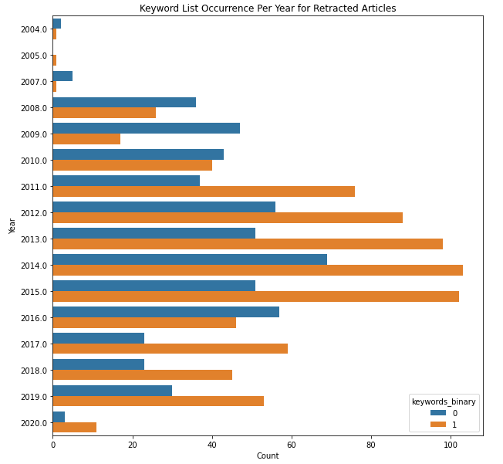

Slide 23
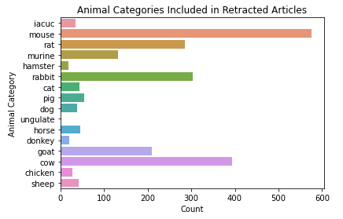
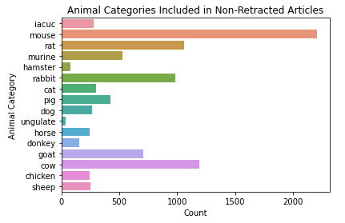

Slide 24
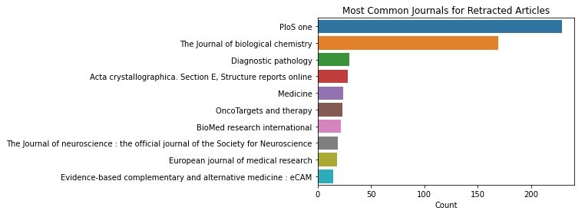

Slide 25
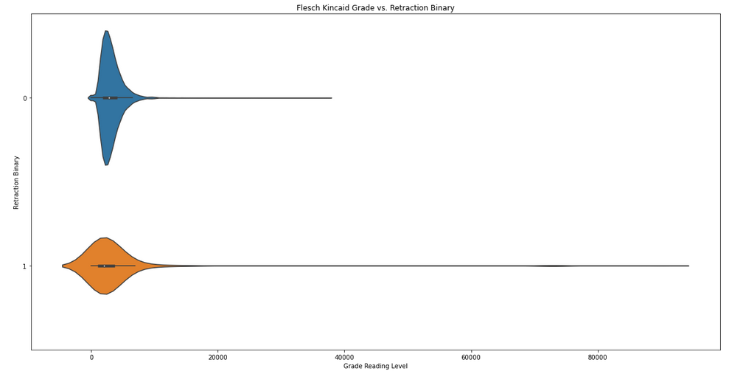

Slide 26
Are there trends in retracted articles?
Retraction Only | No Retraction Only
antibody | difference
vitamin | higher
concentration | found
disease | year
cancer | total
treated | rate
showed | condition
tissue | non
hiv | first
increased | change
serum | age
line | factor
tumor | specie
human | participant
assay | individual
dna | ---
Most common single words found in retracted or non-retracted articles
Retraction article bigrams:
Biological work
Human based work
Non-retraction article bigrams:
Methodology of the project
Complementary research

Slide 27
Naïve Bayes Models – Single Words
Multinomial Naïve Bayes
Parameters | Training Accuracy | Testing Accuracy | Sensitivity | Correct Retractions Detected
5,000 single words | 76.6% | 75.1% | 0.469 | 180
20,000 single words | 85.3% | 79.1% | 0.458 | 176
50,000 single words | 90.3% | 81.9% | 0.440 | 169

Slide 28
Naïve Bayes Models – Bigrams
Multinomial Naïve Bayes
Parameters | Training Accuracy | Testing Accuracy | Sensitivity | Correct Retractions Detected
5,000 bigrams | 86.5% | 86.2% | 0.346 | 133
20,000 bigrams | 88.9% | 87.9% | 0.203 | 78
50,000 bigrams | 86.9% | 86.2% | 0.047 | 18

Slide 29
Decision Tree Variants - Bigrams
Decision Tree Variants
Model | Parameters | Training Accuracy | Testing Accuracy | Sensitivity | Correct Retractions Detected
Decision Tree | Default | 100% | 89.3% | 0.674 | 259
Decision Tree | Max depth = 5, Test size = 0.3 | 91.5% | 90.3% | 0.386 | 178
Random Forest | Default | ~100% | 91.0% | 0.391 | 150

Slide 30
Feature Importance Values
Word | Feature Importance Values
declare | 0.217
µg | 0.128
click | 0.083
analysis | 0.043
figures | 0.035
number | 0.024
author | 0.020
cancer | 0.013
please | 0.010
non | 0.009
Top 10 largest feature importance values for chosen optimized model

